Slide 1

HERE Technologies GuadalaHacks Student Hackathon
May 17 & 18 2025

Slide 2


Slide 3

Using location technology to solve global challenges
HERE Technologies is a location data and technology company that created the first digital map 40 years ago.
Today we are the world's leading location platform company with a global footprint across 52 countries.
We create and maintain a new type of map - a complete, accurate and easy-to-use digital representation of the physical world.

Slide 4
Prizes
1st place team: internships with HERE.
Potential start date: Summer or Fall 2025 (Must be completed before end of 2025)
Duration: 10-12 weeks
Hours: 10-12 hours per week
Option for remote or in-office (Leon)
2nd and 3rd place teams
HERE Developer Blog posts

Slide 5
The Problem:
Automatically Correcting Spatial Validations

Slide 6
Project Overview
The road network is continuously evolving, and we aim to maintain up-to-date maps to enhance navigation and overall user experience.
HERE develops and maintains a robust set of validations to detect issues within the data.
Based on a comprehensive set of rules
Currently 3000+ validations
Intended to reflect reality situations
Cleaned before release
Reviewed: fixed or labeled as “legal exceptions”

Slide 7
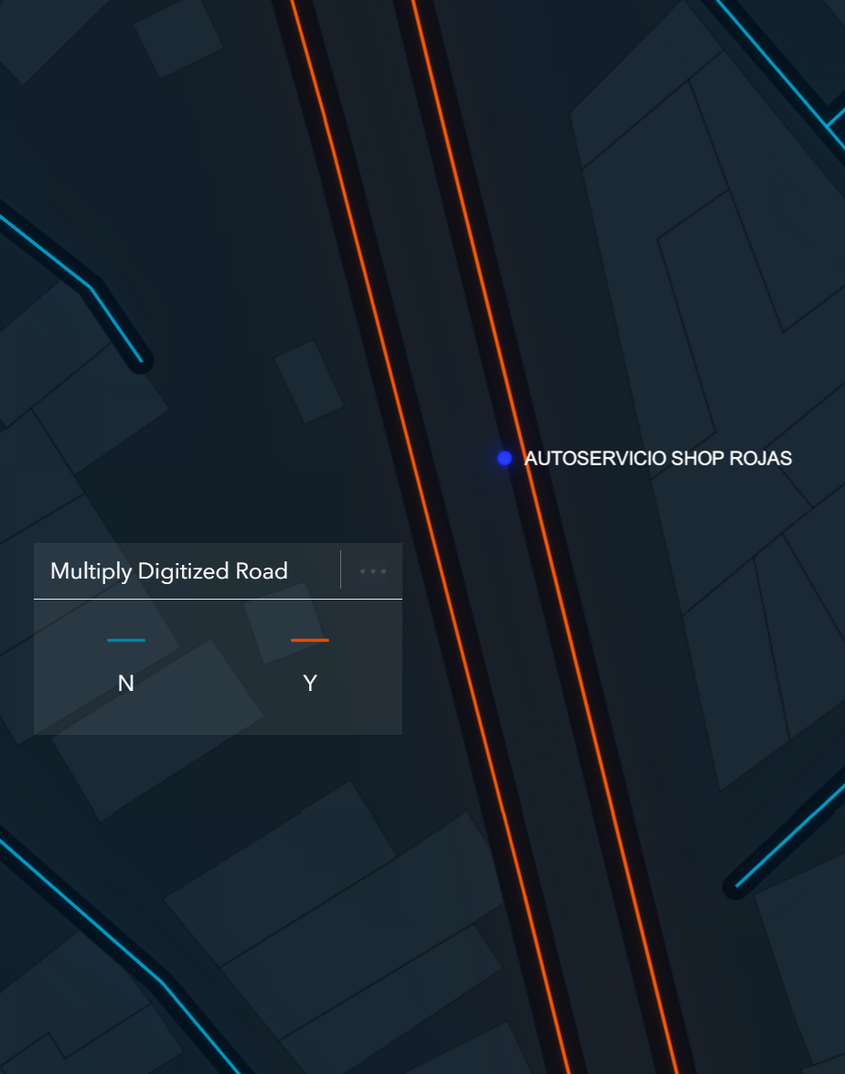
POI295 POI on Inside of Multi-Dig Road
Trigger: A Point of Interest (POI) feature is suspicious when located on the inside of Multiply Digitised roads.
Outcome scenarios:
No POI in reality
Incorrect POI location
Incorrect Multiply Digitised attribution
Legitimate Exception from the rule

Slide 8
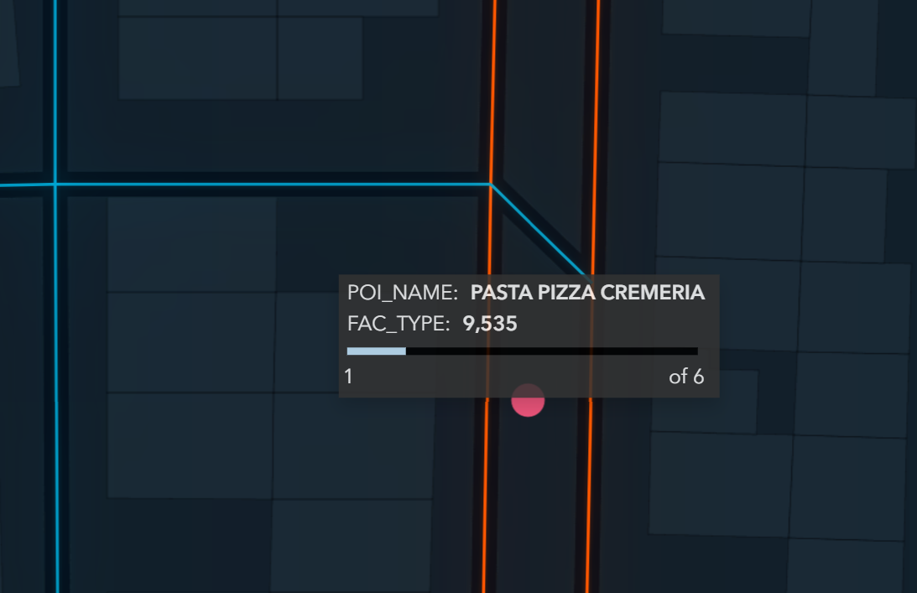
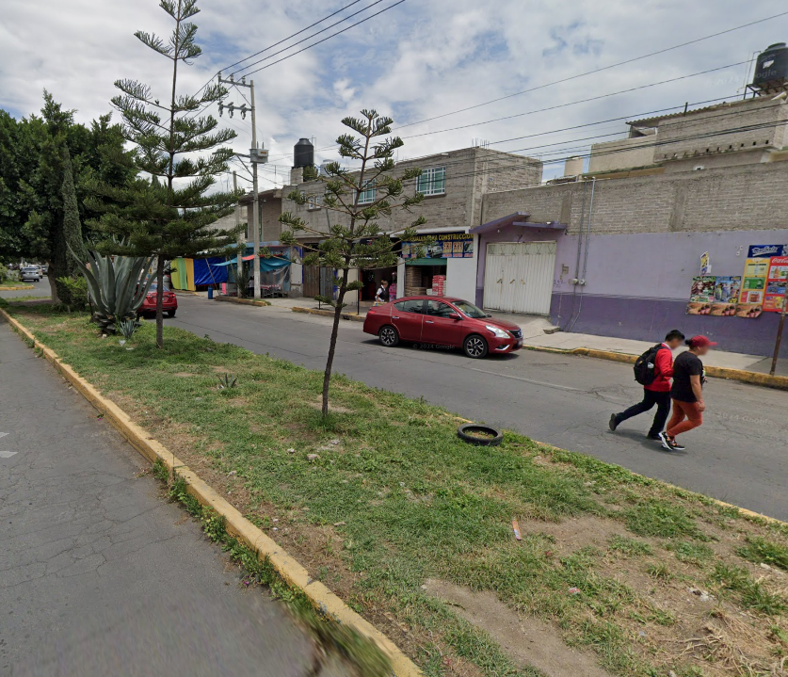
Possible Scenarios (1/4)
Scenario #1: no POI in reality
No POI in reality:
The POI feature is most likely outdated or has been moved.
OUTCOME:
Mark the feature for deletion

Slide 9
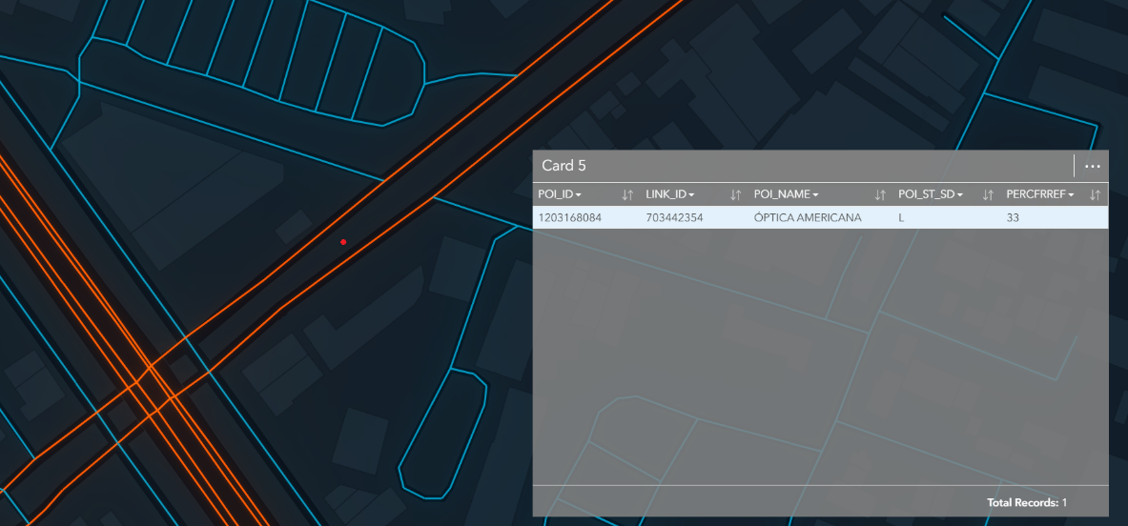
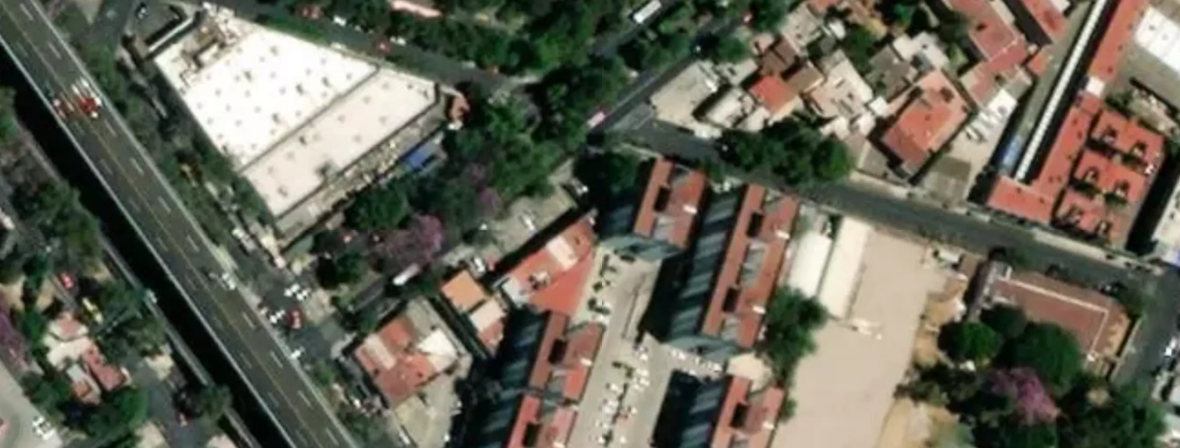
Possible Scenarios (2/4)
Scenario #2: POI placed on incorrect side of the road
Incorrect road matching:
There is a POI in reality, but it has been associated to the wrong side of the road segment.
Actual Street Side = Right
OUTCOME:
Update the POI record with a new associated Link

Slide 10
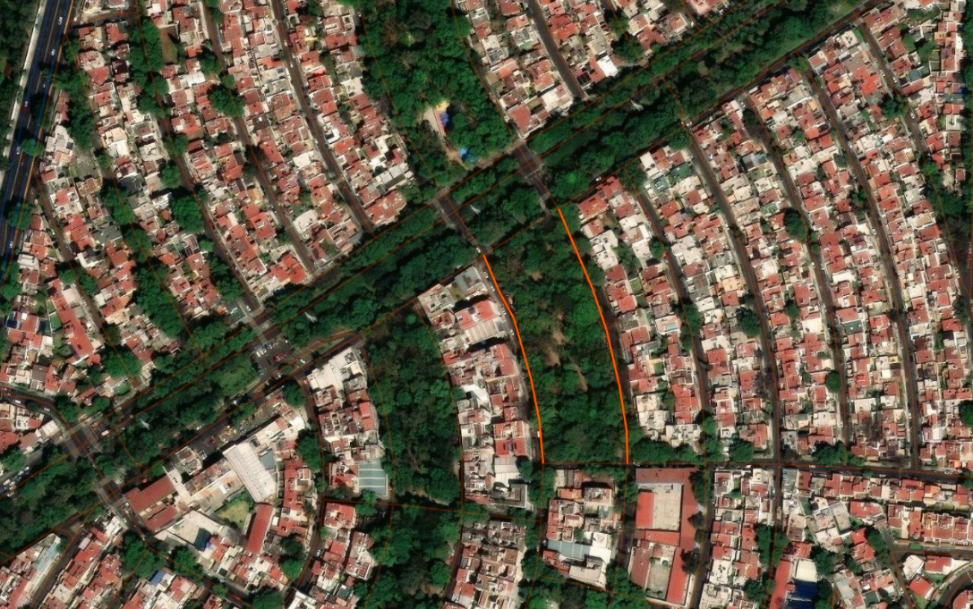
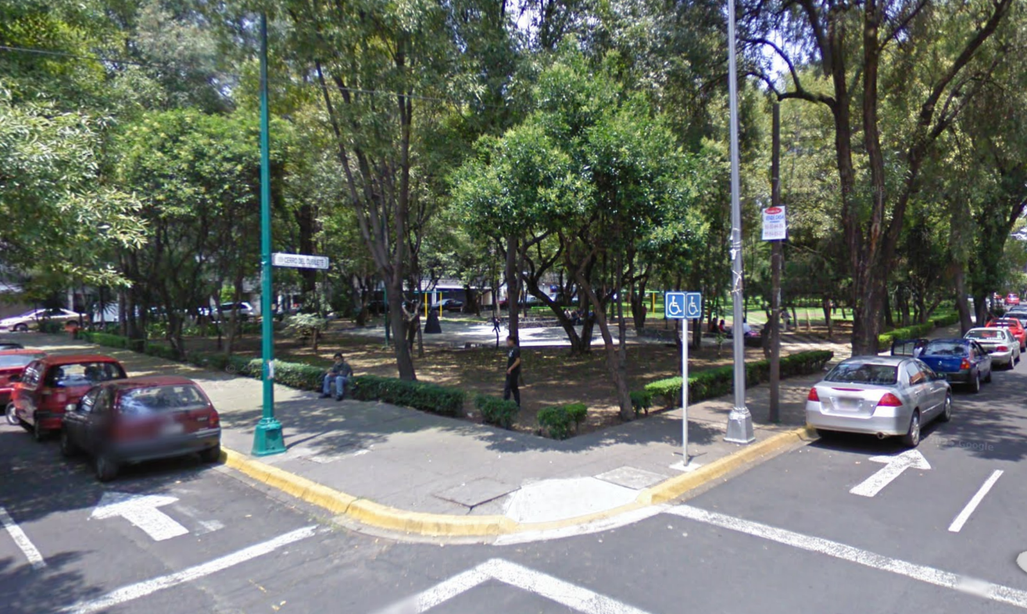
Possible Scenarios (3/4)
Scenario #3: Incorrect Multiply Digitised attribution
Incorrect road attribution:
The POI is in the correct place, however the road segment was erroneously attributed as ‘Multiply Digitised = YES’
OUTCOME:
Update the Link feature’s MULTIDIGIT attribute to ‘N’
See more about Multiply Digitised (MULTIDIGIT) coding in the Navstreets Reference Guide (pg. 468-470).

Slide 11
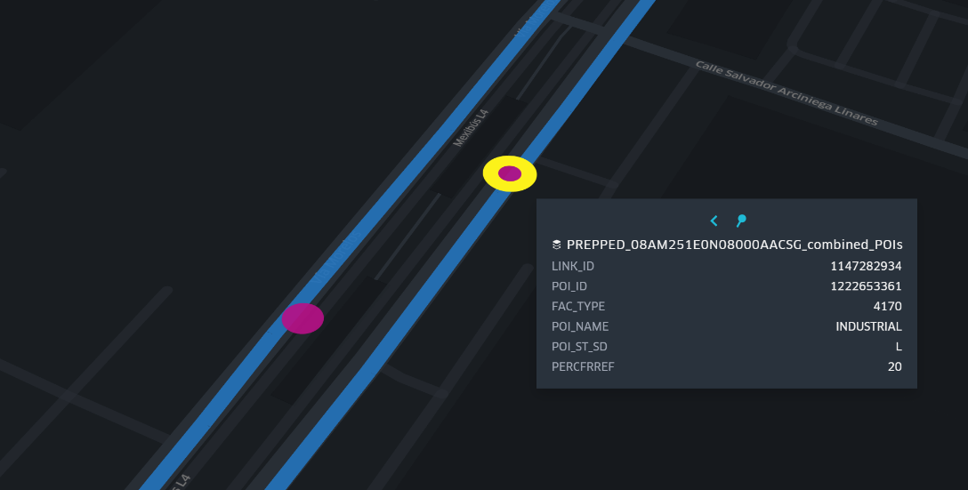
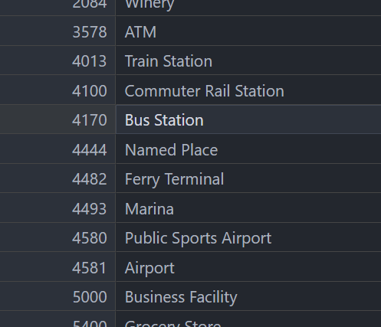
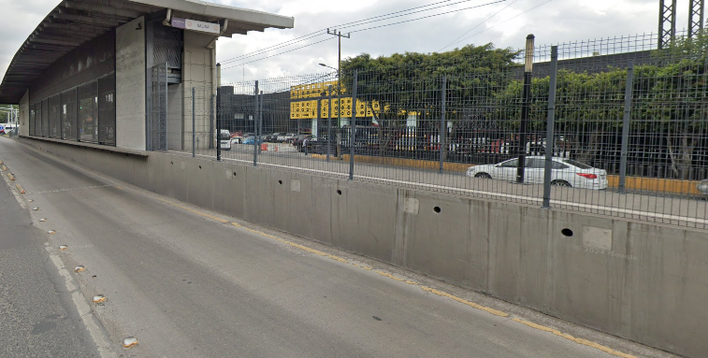
Possible Scenarios (4/4)
Legitimate Exception: correct location and confirmed existence
Valid exception from the rule:
There is a POI in reality and its location within a multi-dig set of road links is correct
OUTCOME:
mark violation as
‘Legitimate Exception’ in the Validations dataset
POI Facility Type Codes

Slide 12
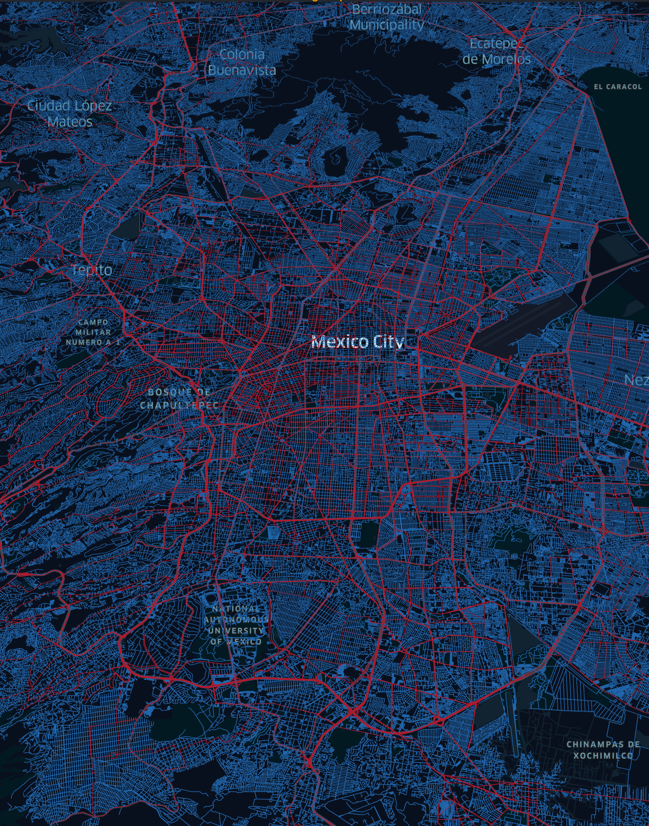
Dataset Characteristics
The provided data includes the Street Network and Places of Interest in parts of Mexico City and surrounding area. It also includes hidden errors…
Included:
Road Network Dataset (geometry, street type etc.)
Points of Interest Dataset (restaurants, banks etc.)
Satellite Imagery (through the HERE REST APIs)
Allowed:
Open-source data (as reference, not as sole data source)

Slide 13
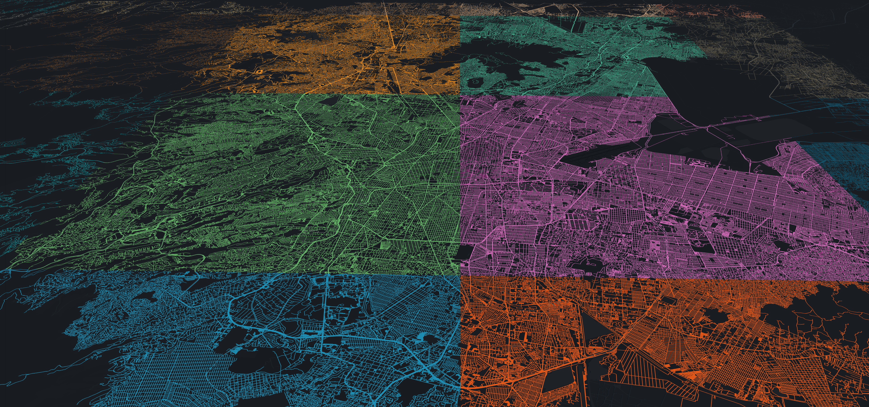
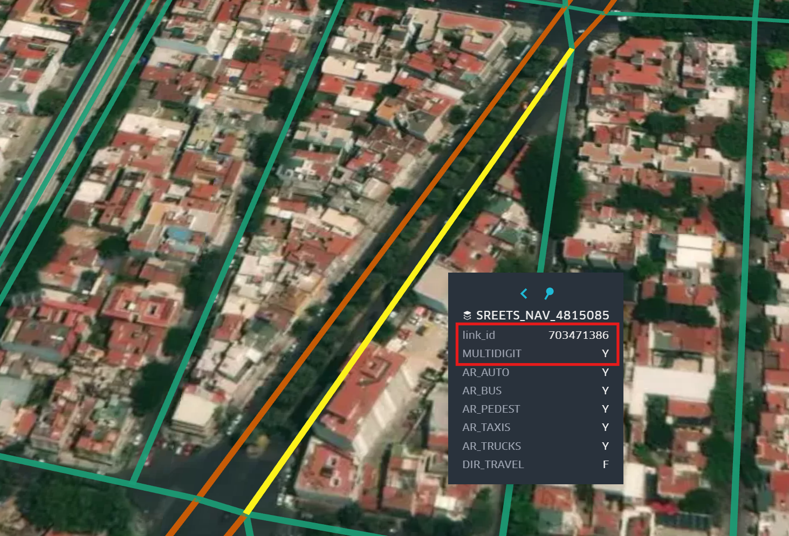
The Datasets
Street Network - Nav Dataset
Definition
The Streets - Nav dataset contains all roads plus Road Network features related to navigation such as direction of travel, dividers, lane counts etc.
Spatial Feature Type: LineString
Location
Geojson files can be found in the ‘STREETS_NAV’ folder.
Data is split into 20 separate files for convenience.
20 ‘tiles’ of Street Network Data
‘link_id’ acts as the unique ID while other columns show relevant attribution of the feature.

Slide 14
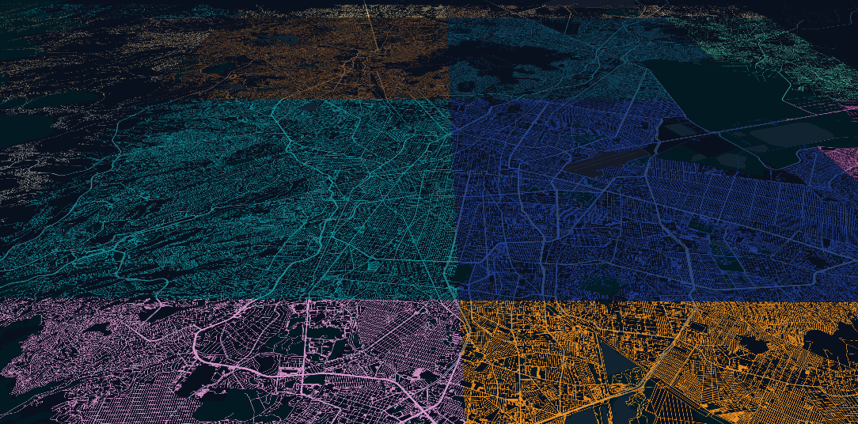
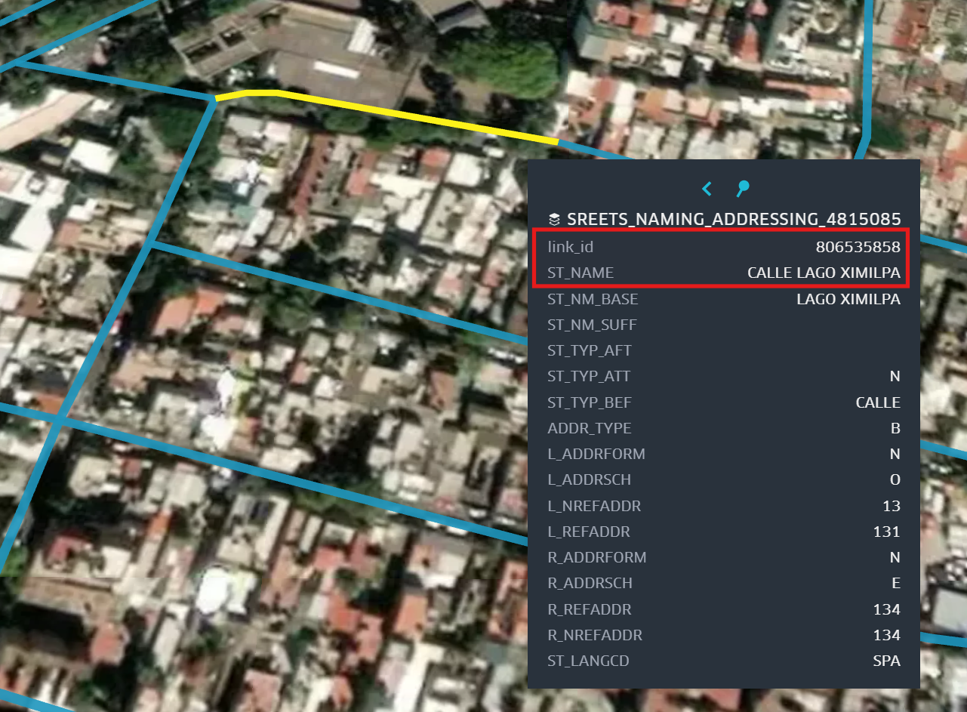
The Datasets
Street Network – Naming & Addressing Dataset
Definition
The Streets – Naming & Addressing dataset contains all roads plus Road Network features related to naming and addressing.
Spatial Feature Type: LineString
Location
Geojson files can be found in the ‘STREETS_NAMING_ADDRESSING’ folder.
Data is split into 20 separate files for convenience.
20 ‘tiles’ of Street Network Data
‘link_id’ acts as the unique ID while other columns show relevant attribution of the feature.

Slide 15
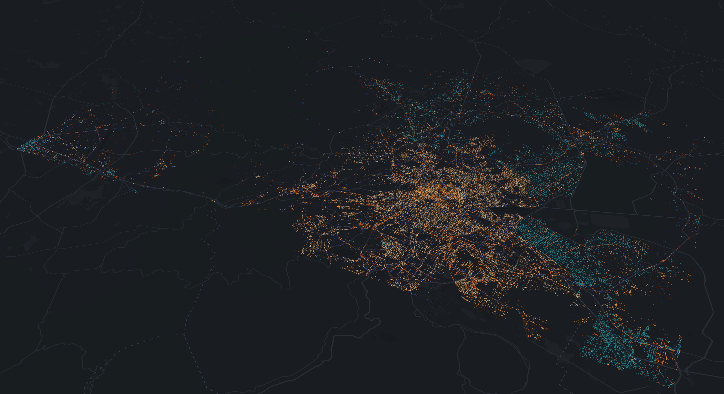
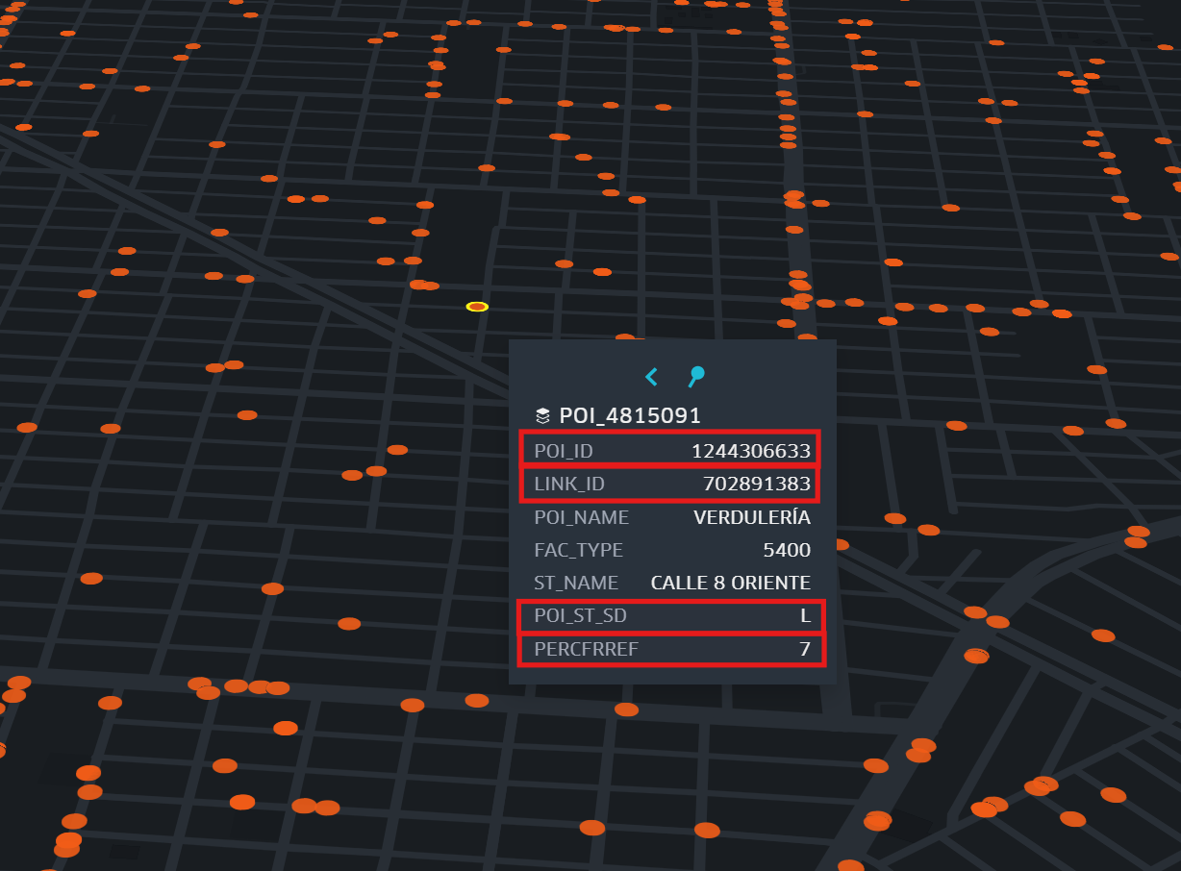
The Datasets
Places of Interest (POI) Dataset
Definition
The POI dataset contains all Places of Interest features along with relevant attribution.
Its location is derived by joining it with the Streets dataset and calculating its placement based on indicated distances.
Spatial Feature Type: Point (but its geometry needs to be derived)
Location
Geojson files can be found in the ‘POIs’ folder.
Data is split into 20 separate files for convenience.
~190,000 POI records in the Mexico City area
LINK_ID = associates POI with a street.
POI_ST_SD = side of street where the POI is located.
PERCREF = indicates the location of the POI on the link in terms of percent from the reference node.
‘POI_ID’ identifies a unique POI record

Slide 16
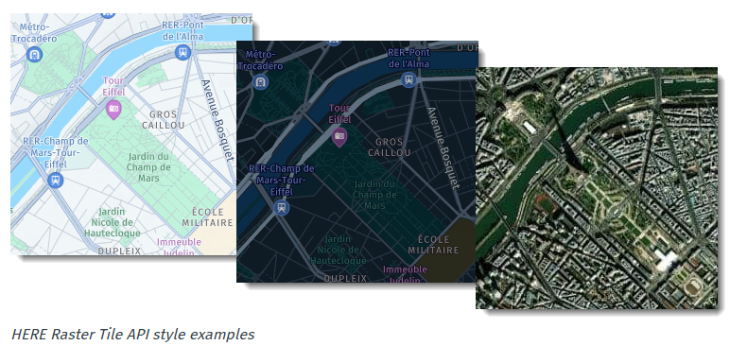
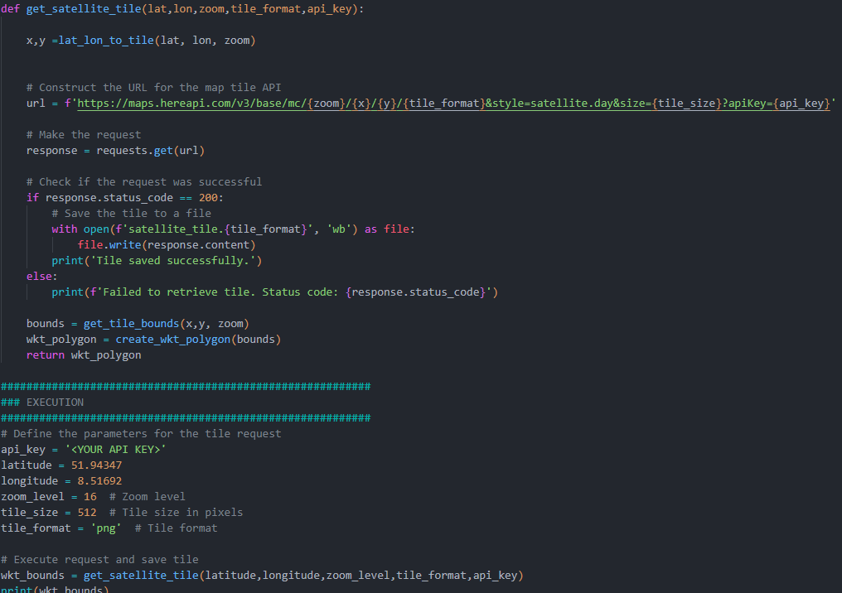
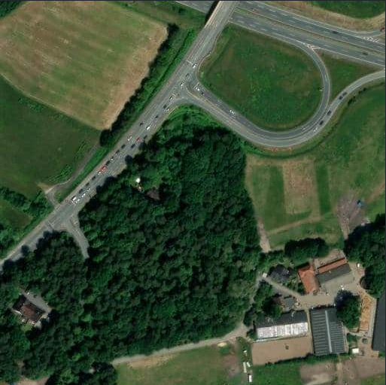
The Datasets
Satellite Imagery (HERE REST API requests)
Definition
The HERE Raster Tile API offers bitmap images with a resolution of either 256x256 or 512x512 pixels.
Satellite imagery is one of the pre-defined response types that can be requested.
Location
Available through REST API requests. Requires API Key (30k request for free in the Base Plan)
How to:
Example python code snippet to request satellite imagery is provided in the docs.
Provided python script
Output png image

Slide 17


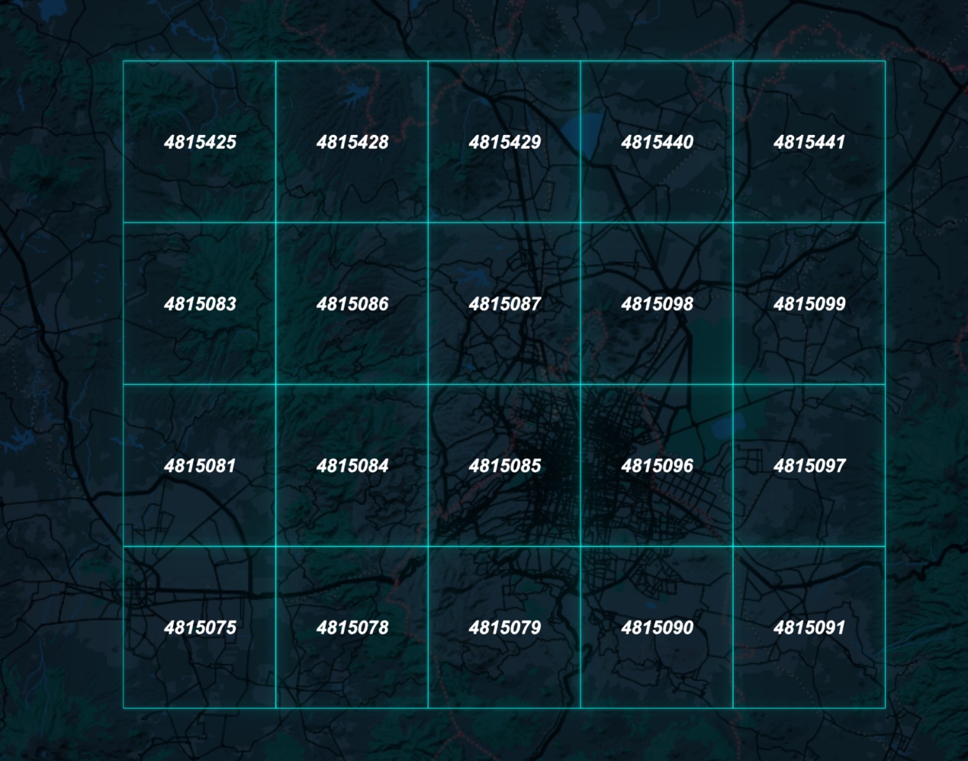

The Datasets
Folder & file structure
HERE_L11_Tiles.geojson
docs
ROOT FOLDER
POIs
STREETS_NAV
STREETS_NAMING_ADDRESSING
POI_4815425.csv
STREETS_NAV_4815425.geojson
SREETS_NAMING_ADDRESSING_4815425.geojson
POI_4815428.csv
STREETS_NAV_4815428.geojson
SREETS_NAMING_ADDRESSING_4815428.geojson
…
…
…
POI_4815091.csv
STREETS_NAV_4815091.geojson
SREETS_NAMING_ADDRESSING_4815091.geojson
Each Data Layer is split into 20 HERE Tiles for easier processing.

Slide 18
Critical Attributes (1/3)
Reference & Non-Reference Nodes of Links
HERE NAVSTREETS Reference Guide page 74
Navstreets feature type: Link
SHAPE POINTS = defines geometric curvature of the road
END NODES = last coord pairs at each ends
Definitions
The Reference Node is the node with the lower latitude.
If the latitudes of both end nodes are identical and their longitudes differ, the Reference Node is determined by the end node with the lower longitude.
If, however, the latitudes and longitudes of both end nodes are identical but their Z-Levels are different, the Reference Node is determined by the end node with the lower Z-Level.
REFERENCE NODE = end node with the lower latitude OR lower longitude if lats are the same.*
*See additional rules in the Navstreets Guide
The importance of the Reference Node
Left side
end
Side Orientation is established using the Reference Node and Non-Reference Nodes.
The Reference Node is located at the “beginning” of a link.
I.e.: the right side of a link is the side on the right when facing the Non-Reference Node.
Right side
start
CASES
Lat A = Lat B
Lat A = Lat B
Lon A = Lon B
Lat A < Lat B
Lon A < Lon B
Ref Node has the lower Z level (height)
REFERENCE NODE
NON-REFERENCE NODE

Slide 19
Critical Attributes (2/3)
POI Road Side & Distance From Reference Node
HERE NAVSTREETS Reference Guide page 52
POIs are associated to Links
LINK_ID = 1124275585
end
A POI feature’s location needs to be defined based on its LINK ID (LINK_ID) association.
The LINK_ID attribute of a POI record identifies which Link it’s associated to.
start
POI_ID = 1203383126
LINK_ID = 1124275585
Definitions
Link ID (LINK_ID) defines which Link the POI is associated to.
Percent From Reference Node (PERCFFREF) is an attribute to a Point Of Interest (POI) and indicates the location of the POI on the link in terms of percent from the reference node.
Side (POI_ST_SD): The side of the street the POI is located on.
POIs are “placed” with the POI_ST_SD attribute
end
start
end
start
POI_ST_SD = R
On the right side if traveling along the link from the Reference Node.
POI_ST_SD = L
On the left side if traveling along the link from the Reference Node.
POI location is defined by the PERCFRREF attribute
Percent From Reference indicates the location of the POI on the link in terms of percent from the reference node.
E.g.: a POI that is approximately at the mid distance point along the geometry has PERCFRREF = 0.5
PERCFFREF = 0.8
The poi is located at ~80% distance marker along the Link’s geometry, from the Ref point
start

Slide 20
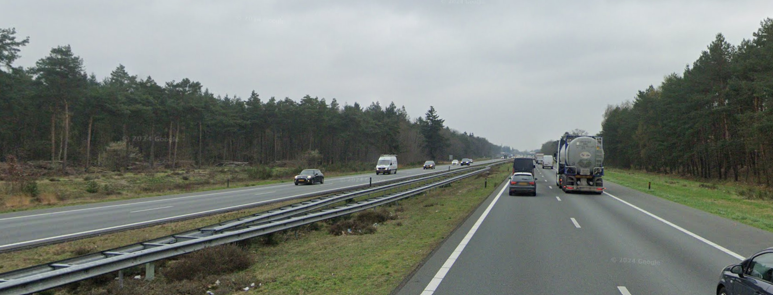
Critical Attributes (3/3)
Multiply Digitised
HERE NAVSTREETS Reference Guide page 468
Definition:
The Multiply Digitised attribute identifies links that are digitised with one line per direction of traffic instead of one line per road and using the rules listed below.
Usage:
For wide roads a link is digitised for each direction of traffic (instead of for each road) in order to improve map matching of the car to the road map.
The Multiply Digitised attribute identifies these opposing lanes of traffic when it is reasonable to represent them as a single line on displays and printed maps.
Conditions*:
Meets distance thresholds between the two roadbeds
Road is not a Ramp, Bi-directional or a Manoeure Link
No heavy vegetation and the Street Name is the same on both sides
Multiply Digitised requirements not met
(heavy vegetation, large distance & different street names)
Multiply Digitised requirements are met
*Check Navstreets Guide for full list.

Slide 21
Expectations
Find a way to fix the data in automated fashion.
The expected outcome is a presentation on how we can help to resolve violations reported by a particular validation rule code without manual intervention.

Slide 22

Bonus opportunity
Goal: Scale this solution for global use.
Challenge: How to make this solution efficient across different countries and road systems.
Task: Propose a theoretical approach to scale the model globally.
Extra Points: Present a practical or innovative method for global scaling.

Slide 23
Additional Resources
Introduction to HERE Mapping Concepts: User Guide
HERE Platform (free access available)
HERE Rest API Information
General HERE Documentation Search
Questions?
Chat via Teams
Email:
kelli.vogt@here.com
akos.magdo@here.com

Slide 24

Get Started: Download data

Slide 25
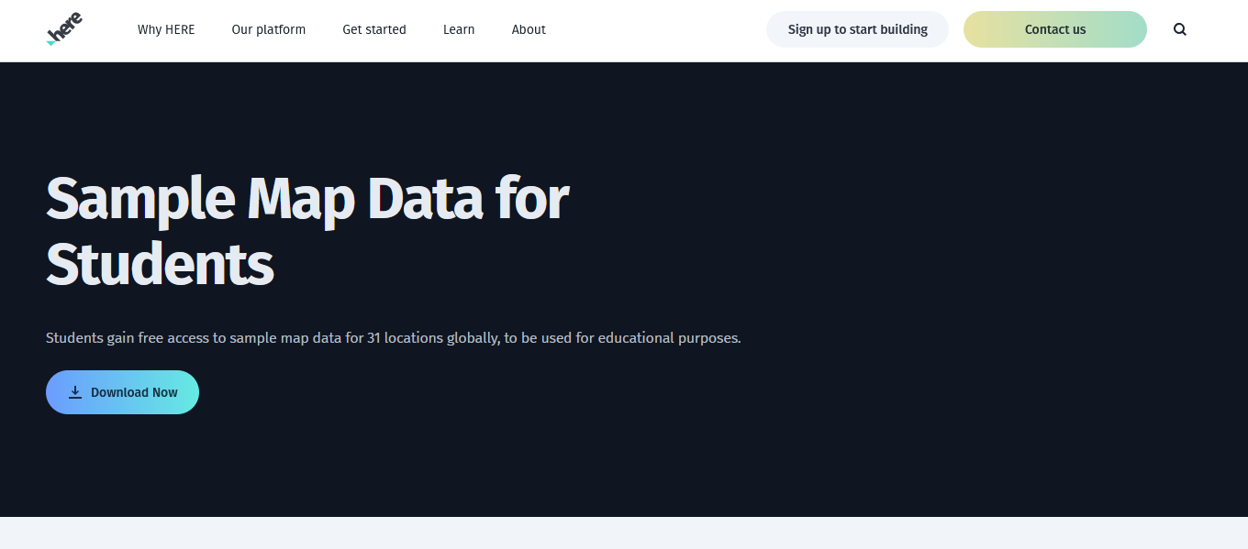

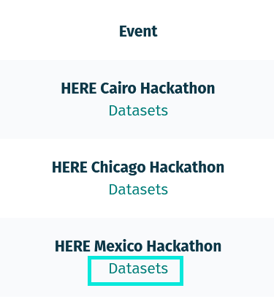
Notes:
https://here-studentsampledata.s3.eu-west-2.amazonaws.com/data_chicago_hackathon_2024.zip

